Slide 1
Student Learning Outcomes in Taskstream
Summer 2020 Workshop: Taskstream Series #1
presented by: Mary Elizabeth Spence
July 6, 2020
AState.edu
/ArkansasState
@ArkansasState

Slide 2
Workshop Procedures
Welcome and thank you for participating in our Summer Workshop Series!
You will be muted upon entry to the workshop, so please introduce yourself via the Chat feature by clicking “Chat.”
The window to the right will appear where you can add your introduction:
If you have questions during the session, please add them to the Chat box and at the conclusion of our time we will include them in the Q and A.
AState.edu
/ArkansasState
@ArkansasState

Slide 3
Workshop Agenda
Attendees will be able to:
Enter and Edit PLOs and Outcome Sets in Taskstream, including:
How to “Hide” Discontinued Outcomes
Align or “Map” PLOs to other sets, including:
Prescribed Standards Sets
ULOs
Add Learning Outcome Sets to Annual Cycles
AState.edu
/ArkansasState
@ArkansasState

Slide 4
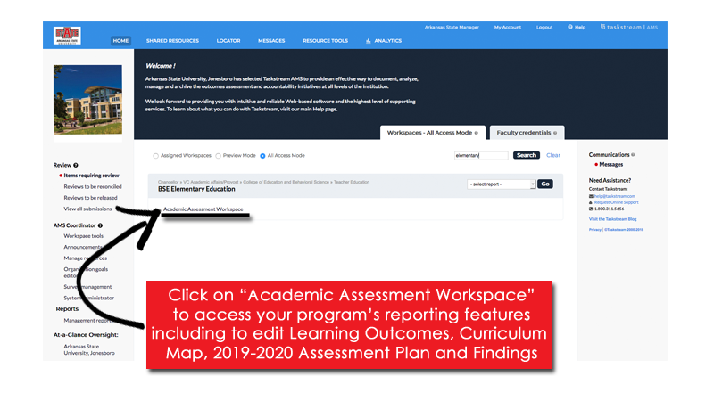
Taskstream Welcome Screen
This screen will show any Programs that you have access to view/edit.
AState.edu
/ArkansasState
@ArkansasState

Slide 5
Workspace Landing Screen
This is the initial screen you will see when you select a Workspace.
AState.edu
/ArkansasState
@ArkansasState

Slide 6
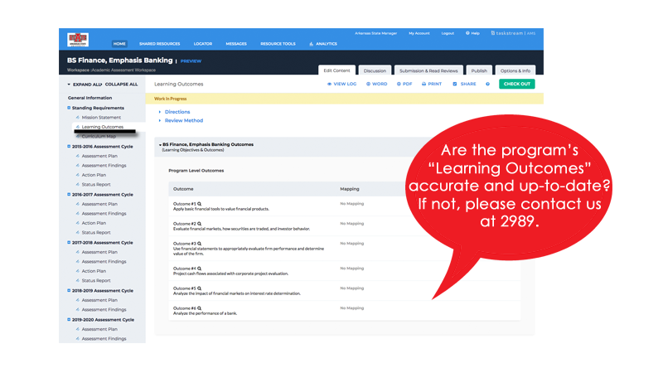
Learning Outcomes
Click on “Learning Outcomes” on the Left Toolbar
AState.edu
/ArkansasState
@ArkansasState

Slide 7
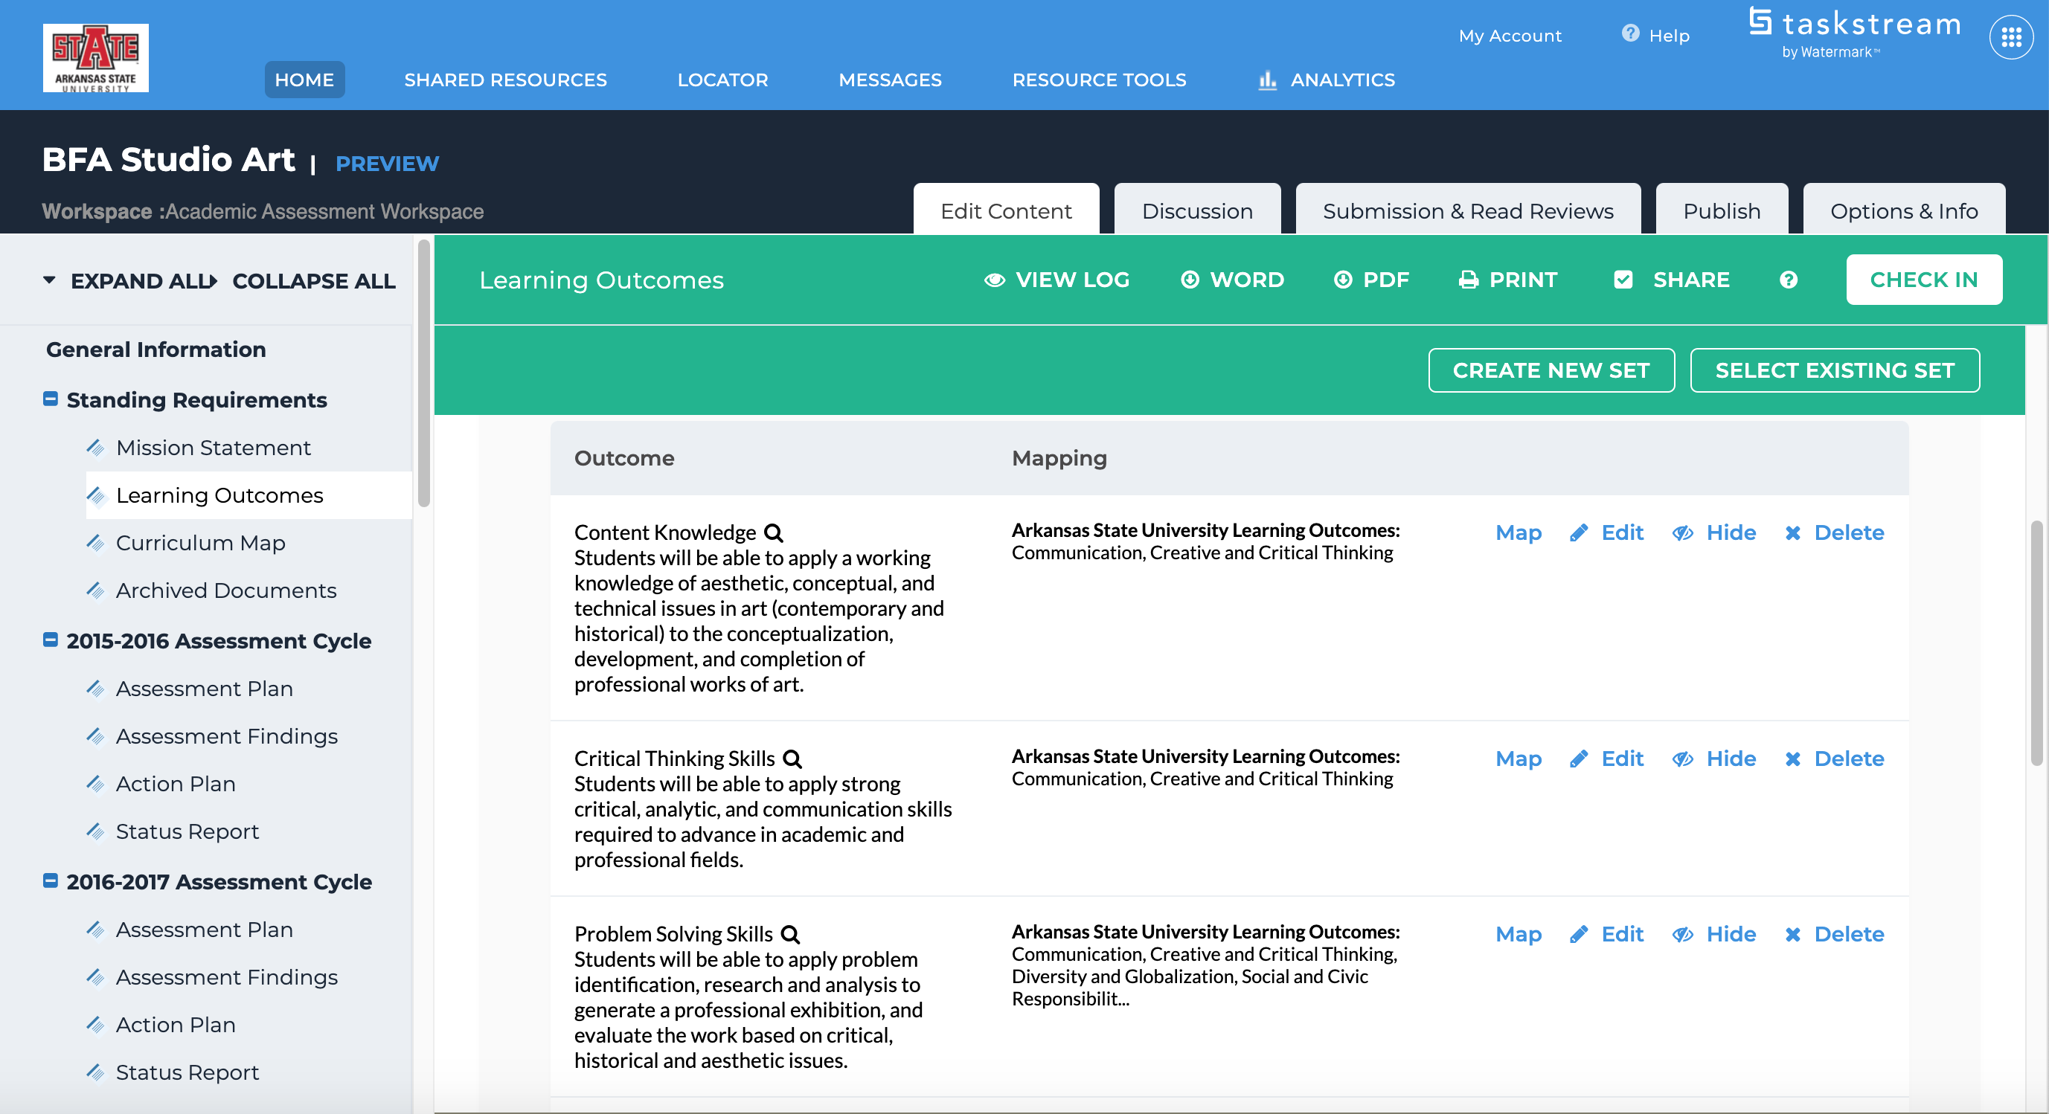
“Map” or Align Learning Outcomes
Click “Check Out” for options to Align (”Map”), Hide or Delete Outcomes
AState.edu
/ArkansasState
@ArkansasState

Slide 8
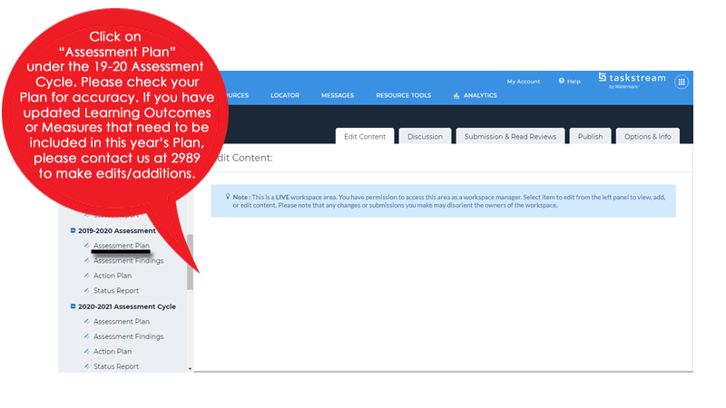
Assessment Plan
AState.edu
/ArkansasState
@ArkansasState

Slide 9
Session Q & A
AState.edu
/ArkansasState
@ArkansasState

Slide 10
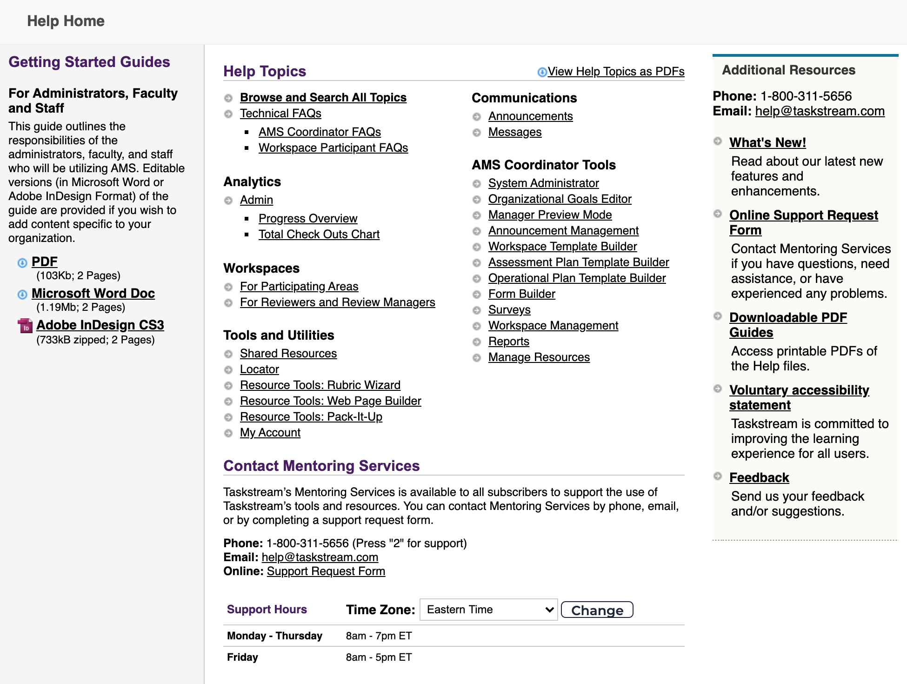
Taskstream Help
For “after hours” assistance, Taskstream has a number of great resources including contact by email and phone and a substantial set of guides. All can be accessed by clicking “? Help”:
AState.edu
/ArkansasState
@ArkansasState

